Slide 1


Ratings Prediction
Abhishek Pai

Slide 2
Problem Statement
A client who has a website where people write different reviews for technical products. Now they are adding a new feature to their website i.E. The reviewer will have to add stars(rating) as well with the review. The rating is out 5 stars and it only has 5 options available 1 star, 2 stars, 3 stars, 4 stars, 5 stars. Now they want to predict ratings for the reviews which were written in the past and they don’t have a rating. So, we have to build an application which can predict the rating by seeing the review.

Slide 3
Steps Followed
Scraping Data
The data has been scraped form various websites and stored in data frame and then a csv file was been generated
Cleaning data
The generated CSV is being loaded and merged and later being cleaned and balanced for starting NLP
Building Model
NLP being done the model is used to predict test data and some hardcoded values to test its accuracy

Slide 4
Data Collection Phase
20000+ rows of data has be scraped for better the model .This section contains the reviews of different laptops, Phones, Headphones, smart watches, Professional Cameras, Printers, Monitors, Home theater, Router from different ecommerce websites.
Basically, the columns are
1) reviews of the product.
2) rating of the product.
The other data was fetch which was being removed in cleaning process

Slide 5
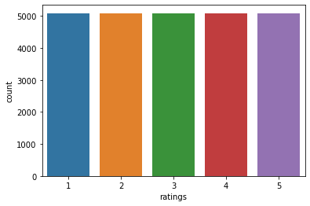
Graph of balanced dataset

Slide 6
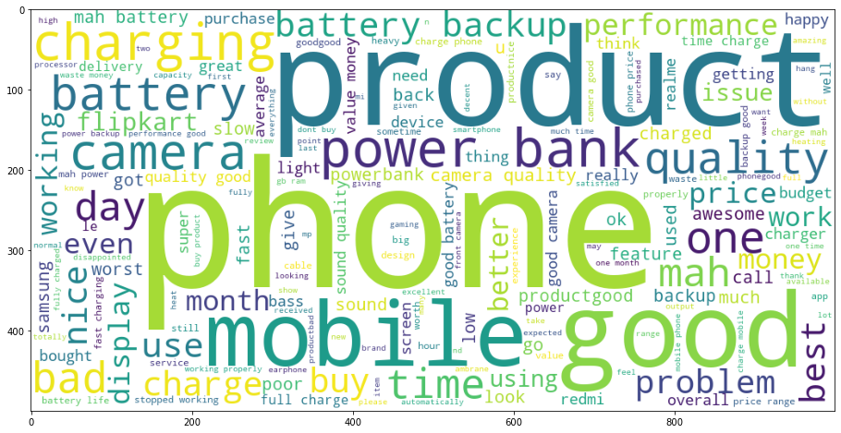
Cloud of Words based on tokens

Slide 7
Model Building Phase
After collecting the data, a machine learning model was build . Before model building all data preprocessing steps involving NLP was being followed.
The complete life cycle of data science was being followed. Including all the steps like
1. Data Cleaning
2. Exploratory Data Analysis
3. Data Preprocessing
4. Model Building
5. Model Evaluation
6. Selecting the best mode

Slide 8
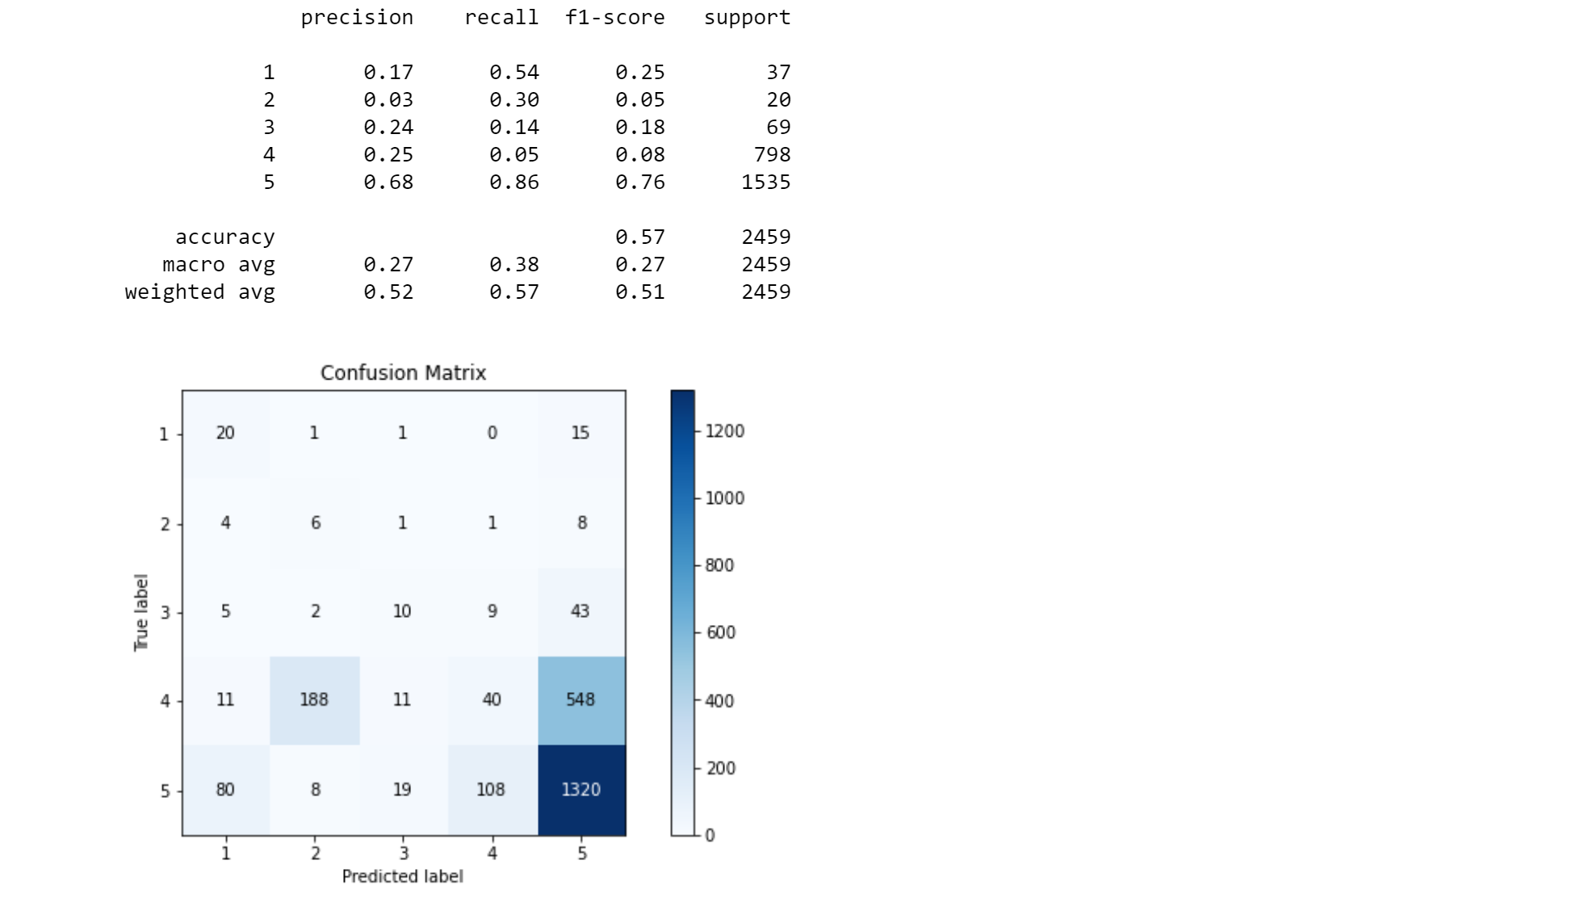
Classification Report

Slide 9
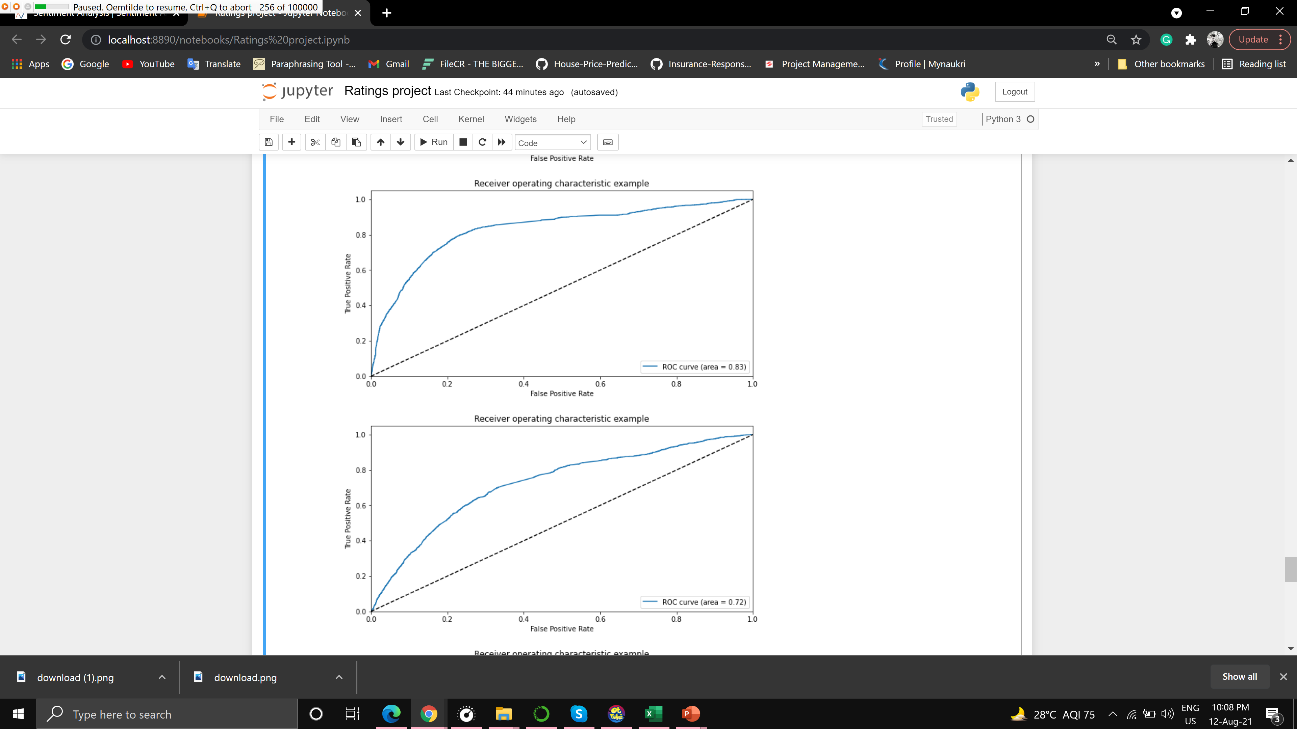

Roc Curve

Slide 10
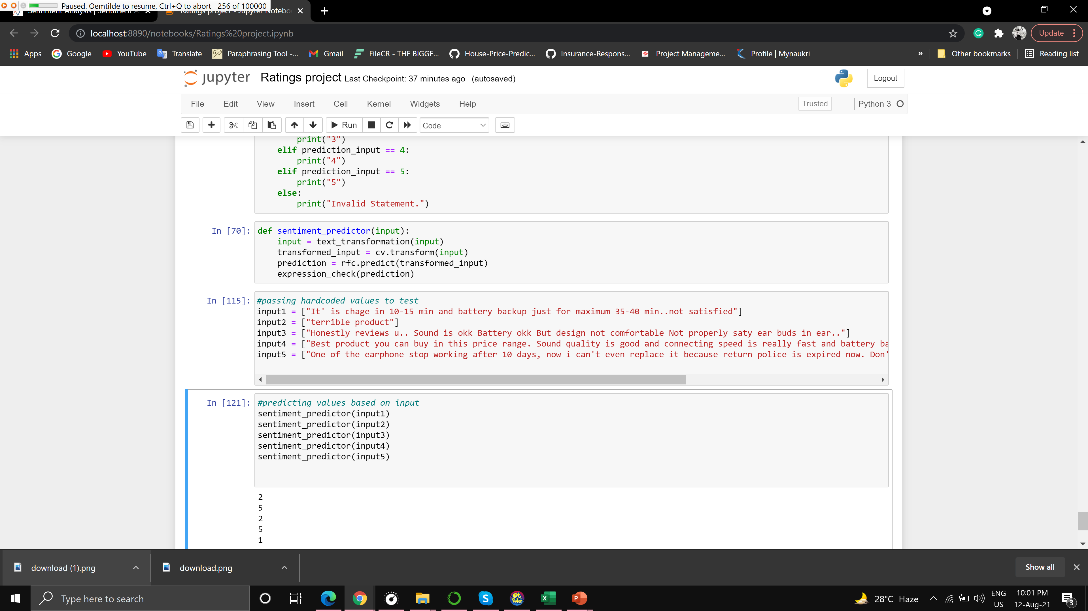
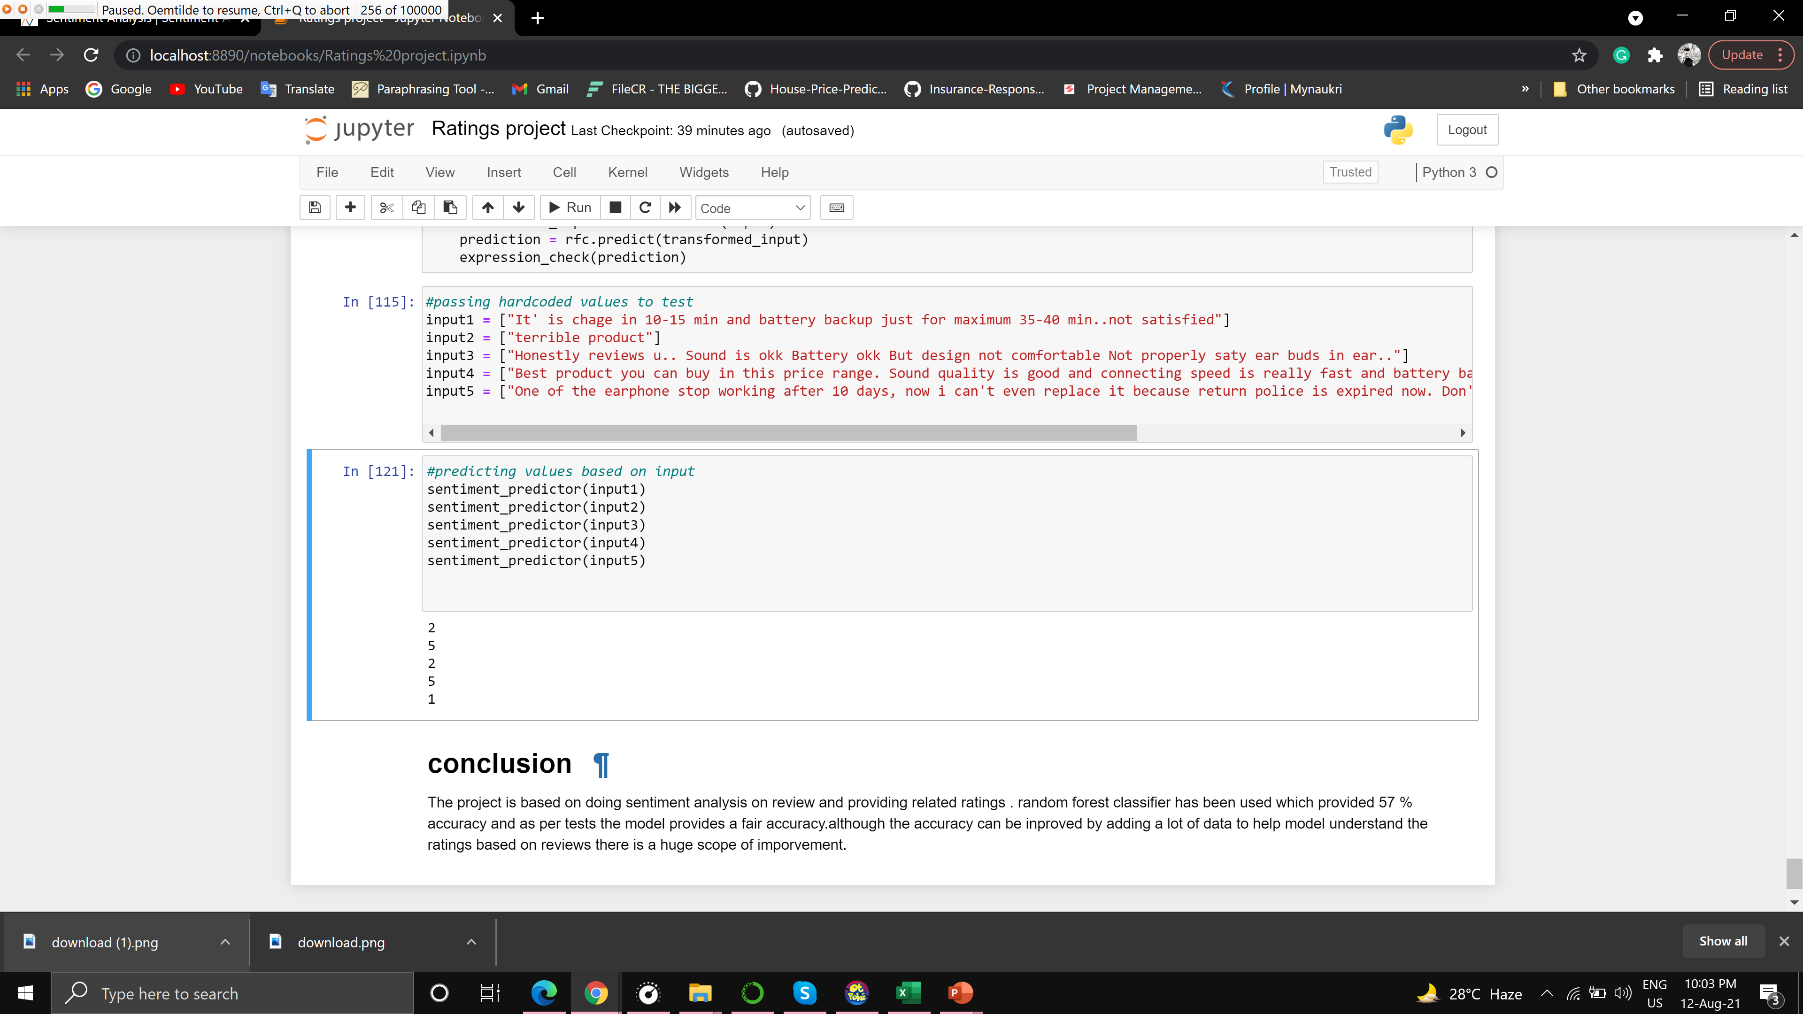
Sample Prediction
Input
Output

Slide 11
Conclusion
The project is based on doing sentiment analysis on review and providing related ratings . random forest classifier has been used which provided 57 % accuracy and as per tests the model provides a fair accuracy. Although the accuracy can be improved by adding a lot of data to help model understand the ratings based on reviews there is a huge scope of improvement.

